Slide 1

A Feasibility Study to Measure Public Funding of R&D to Universities & Nonprofits Using Administrative Data
(Today's focus is on Science & Engineering funding to Universities)
9 August 2019

Slide 2
The NCSES UVA Team
NCSES
John Jankowski
Chris Pece
Audrey Kindlon
Gary Anderson
UVA
Stephanie Shipp
Sam Cohen
Joel Thurston
Alyssa Fowers
Sean Pietrowicz

Slide 3
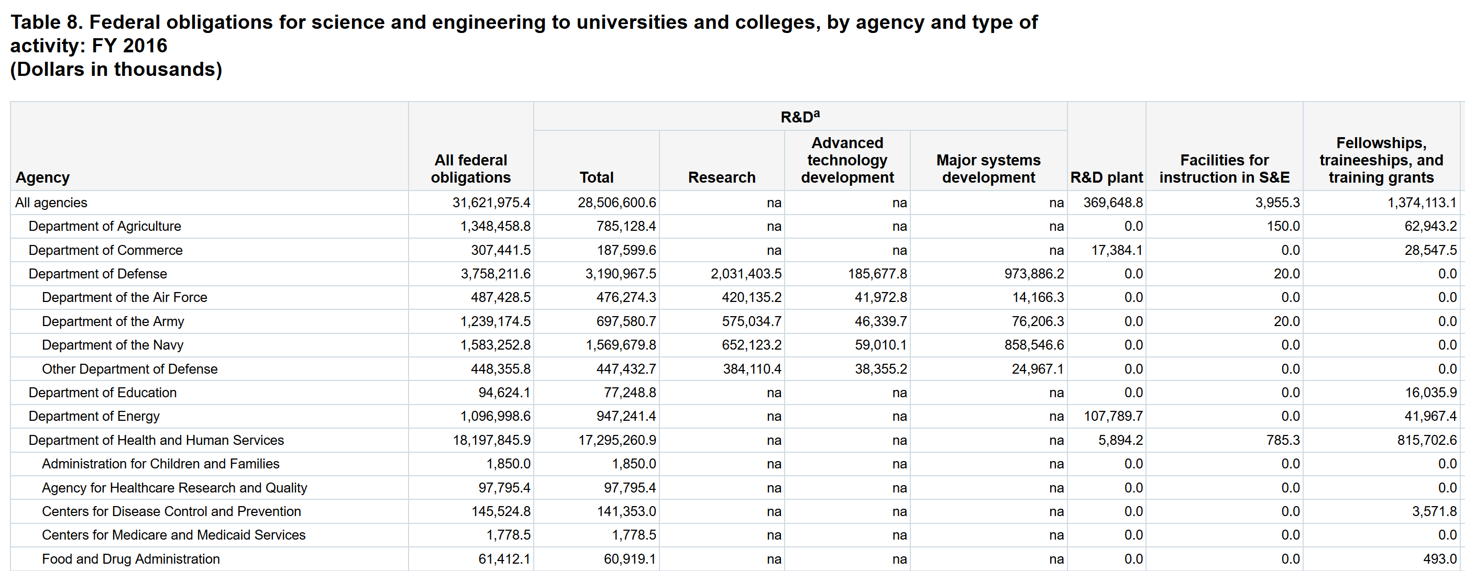
Can we measure R&D at micro level using administrative data?
https://ncsesdata.nsf.gov/fedsupport/2016/html/FSS2016_DST_08.html
Notes:
Can we replace survey data with administrative data?
Motivate: These are the sort of outputs produced by the FSS. Could we produce something similar relying solely on publicly available information? How else can we use data science to complement the findings of FSS, such as offering greater granularity? Compiling all abstracts into a location so that the public could see the use of funds more clearly?

Slide 4
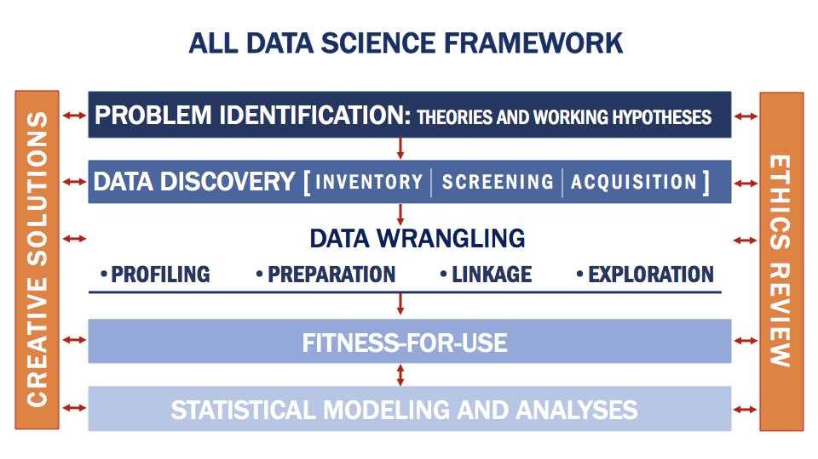
The SDAD Data Science Framework
Notes:
At SDAD, we've developed an extremely comprehensive model for turning discovered data into a workable product for drawing novel conclusions. This framework includes data discovery, where we identify multiple data sources for testing a problem and screening their quality for the problem at hand. We then further profile potential data, and if it meets our standards, we will wrangle one or more of these sources into a coherent, consistent format. These results are further evaluated for acceptability for use, before we begin to answer the problem at hand. At each step, we consider both creative solutions and ethical considerations for using the data.

Slide 5
What is R&D and S&E?
Research and Development (R&D): Basic and applied research and technological developments
Excluding R&D plant for now
Science and Engineering (S&E): scientific activity including R&D
Including training, conferences, career pipelines, teaching and fellowships
Source: National Science Foundation, National Center for Science and Engineering Statistics, Survey of Federal Science and Engineering Support to Universities, Colleges, and Nonprofit Institutions (FSS)

Slide 6
Ethical Review of Research
The databases for this project are entirely available to the public and contains no confidential or classified information.
Because our goal is to document and organize already existing public information, there appears to be no potential for ethical conflicts in this project.

Slide 7
Requirements to compare administrative data to FSS
Intended use of funds (R&D)
Project-level data
Recipient of funds
Dates based on transaction

Slide 8














Focus is on the six agencies compromising the majority of R&D funding

Slide 9

Data Discovery & Screening
Asked 27 screening questions of 11 publicly available databases (handout)
Good date coverage, some direct downloads available, detailed information about agencies funding of R&D and S&E

Slide 10
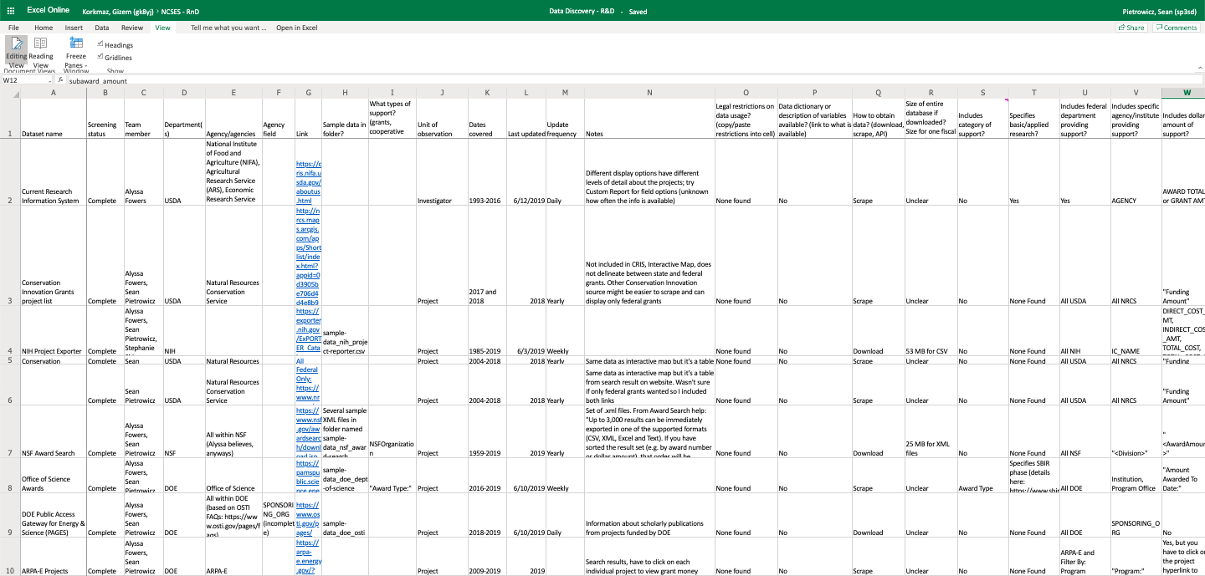
Data Discovery: Screening

Slide 11
Data screening suggests no “perfect” data source
Ease of obtaining/ interpreting data
Matching to survey data
Enabling detailed analysis
Basic information
Data dictionaries
Linked to publications
R&D vs general S&E
Basic vs applied research
Grants vs cooperative agreements
Institution type
Notes:
Asked 27 screening questions of 11 publicly available databases.
Good date coverage, some direct downloads available, detailed information about areas of inquiry and research institutions.
Hand out available

Slide 12


Data Discovery
Each agency has some amount of coverage in our data sources, but we are still evaluating the completeness of that coverage.
Energy
Defense
Source
USA Spending
Federal Reporter
Current Research Information System
Conservation Innovation Grants project list
NIH Project Exporter
Conservation Innovation Grants All Project List
NSF Award Search
Office of Science Awards
DOE Public Access Gateway for Energy & Science (PAGES)
ARPA-E Projects
Total Potential Data Sources | 4 | 2 | 2 | 3 | 3 | 5

Slide 13

What's included Federal Reporter and USA Spending?
Title: Novel Cathode for Long-Cycling Capacititive Deionization
Award notice date: 9/19/2016 (FY16)
Start date: 10/1/2016 (FY17)
Federal Report fiscal year: 2016
Federal Reporter total: $744,440
USA Spending 2016 Transactions: 0
2016 transaction total: $0
Title: Center for Hybrid Multicore Productivity Research
Award notice date: 8/1/2016 (FY16)
Start date: 8/1/2016 (FY16)
Federal Reporter fiscal year: 2016
Federal Reporter year total: $199,974
USA Spending 2016 transactions: 2
2016 transaction total: $199,974
Title: University-National Oceanographic Laboratory
Award notice date: 8/4/2014 (FY14)
Start date: 5/1/2014 (FY14)
Federal Reporter fiscal year: 2014
Federal Reporter year total: $0
USA Spending 2016 transactions: 6
2016 transaction total: $1,277,057
Federal Reporter
USA Spending
Federal Reporter
USA Spending
Federal Reporter
USA Spending
Conclusion: focus on USA Spending, but try to connect to Fed RePORTER details.

Slide 14
USA Spending is the most comprehensive source of data
Project-level data
Can specify recipients of interest, e.g. universities, nonprofits
Organized by individual payments
Challenges
Funding beyond R&D and S&E
Contracts and grants treated differently
Benefits

Slide 15
Data Profiling
Assessing data quality:
Completeness: % of values that are not blank or NA
Value validity: % of values in the right format for information (e.g. project code format, CFDA codes, )
What percentage of projects and funding is accounted for?
%, count, and total dollar amount of grants and contracts in each agency - compare against the Federal Support Survey (FSS)

Slide 16
Data Profiling Example #1
Evaluated character lengths of project titles and noticed several entries that were much longer than expected
Revealed to contain project abstracts, not titles!
 | PROJECT_TITLE
1 | THE PROPOSED WORK CONTRIBUTES IN A SIGNIFICANT WAY BY CREATING A FORMAL LINK BETWEEN WEDC AND THE ELMIRA CITY SCHOOL DISTRICT THROUGH A NASA STEM EXHIBIT AND ASSOCIATED STEM CURRICULA. THE TARGETED AUDIENCE OF THE PROPOSED WORK IS GRADES K THROUGH 12 LOW
2 | PARTICULATE ORGANIC MATTER POM IN THE UPPER OCEAN IS SUBJECT TO ADVECTION BY NEAR SURFACE VELOCITIES RELATED TO THE DYNAMICS OF EDDIES, FRONTS AND MIXED LAYER INSTABILITIES. THIS ADVECTION INFLUENCES BOTH THE HORIZONTAL AND VERTICAL DISTRIBUTIONS OF POM.
3 | SCANNING TRANSMISSION ELECTRON MICROSCOPY OF LABORATORY SPACE WEATHERED PARTICLES THE GOAL OF THIS PROPOSAL IS TO CHARACTERIZE SPACE-WEATHERING EFFECTS AS A FUNCTION OF REGOLITH TEMPERATURE, ENERGY SOURCE AND VOLATILE CONTENT BY SCANNING TRANSMISSION ELE
4 | SCIENCE GOALS AND OBJECTIVES: THE SCIENTIFIC OBJECTIVE OF THIS EFFORT IS TO DEVELOP A BETTER UNDERSTANDING OF ELECTROMAGNETIC SCATTERING FROM PLANETARY SURFACES USING THEORY AND COMPUTER SIMULATIONS. ONE GOAL IS TO UNDERSTAND HOW THE AMPLITUDE AND POLARI
5 | UNDERSTANDING AND FORECASTING CHANGES IN HIGH MOUNTAIN ASIA SNOW HYDROLOGY VIA A NOVEL BAYESIAN REANALYSIS AND MODELINGAPPROACH SEASONAL SNOW OVER HIGH MOUNTAIN ASIA (HMA) CONSTITUTES ONE OF THE MOST IMPORTANT COMPONENTS OF THE REGIONAL HYDROLOGIC CYCLE,

Slide 17
Data Profiling Example #2
Example Project from Sub-Agency | Award Code (Notation in USA Spending)
DOD – CDMRP The Role of Desert-Dust Metals in the Pathobiology of Gulf War Illness | W81XWH1620050
HHS – NIH VACCINE AND CELL THERAPY CORE LABORATORY | P30CA016087
USDA – ARS Crop and Water Sustainability in Upper Mississippi River Basin Agroecosystems | 58-5030-5-080-1
DoD Activity Address Code
National Cancer Institute Funding
Project conducted through NLAE in Ames, IA

Slide 18
Pilot Benchmarking of S&E and R&D

Slide 19
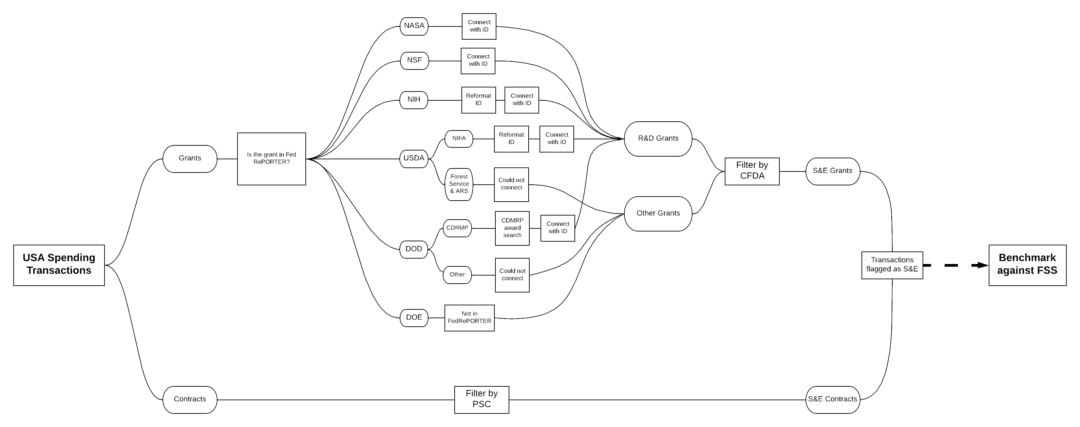
Original Feasibility Approach
Separate
Screen
Total

Slide 20
Screening Grants with Federal RePORTER
Separate
Screen
Total

Slide 21
Federal Reporter Strategy
Federal Reporter is an NIH-run public database of R&D funding that supplies award funding information for 5 out of 6 agencies of interest
Linked most Federal Reporter projects with USAspending transaction data using unique project identifiers as way of screening R&D
If project is found in Federal Reporter, then it is R&D
Decided that CFDA classification method was more efficient, but learned valuable information about the databases
Used results of this method to check our work

Slide 22
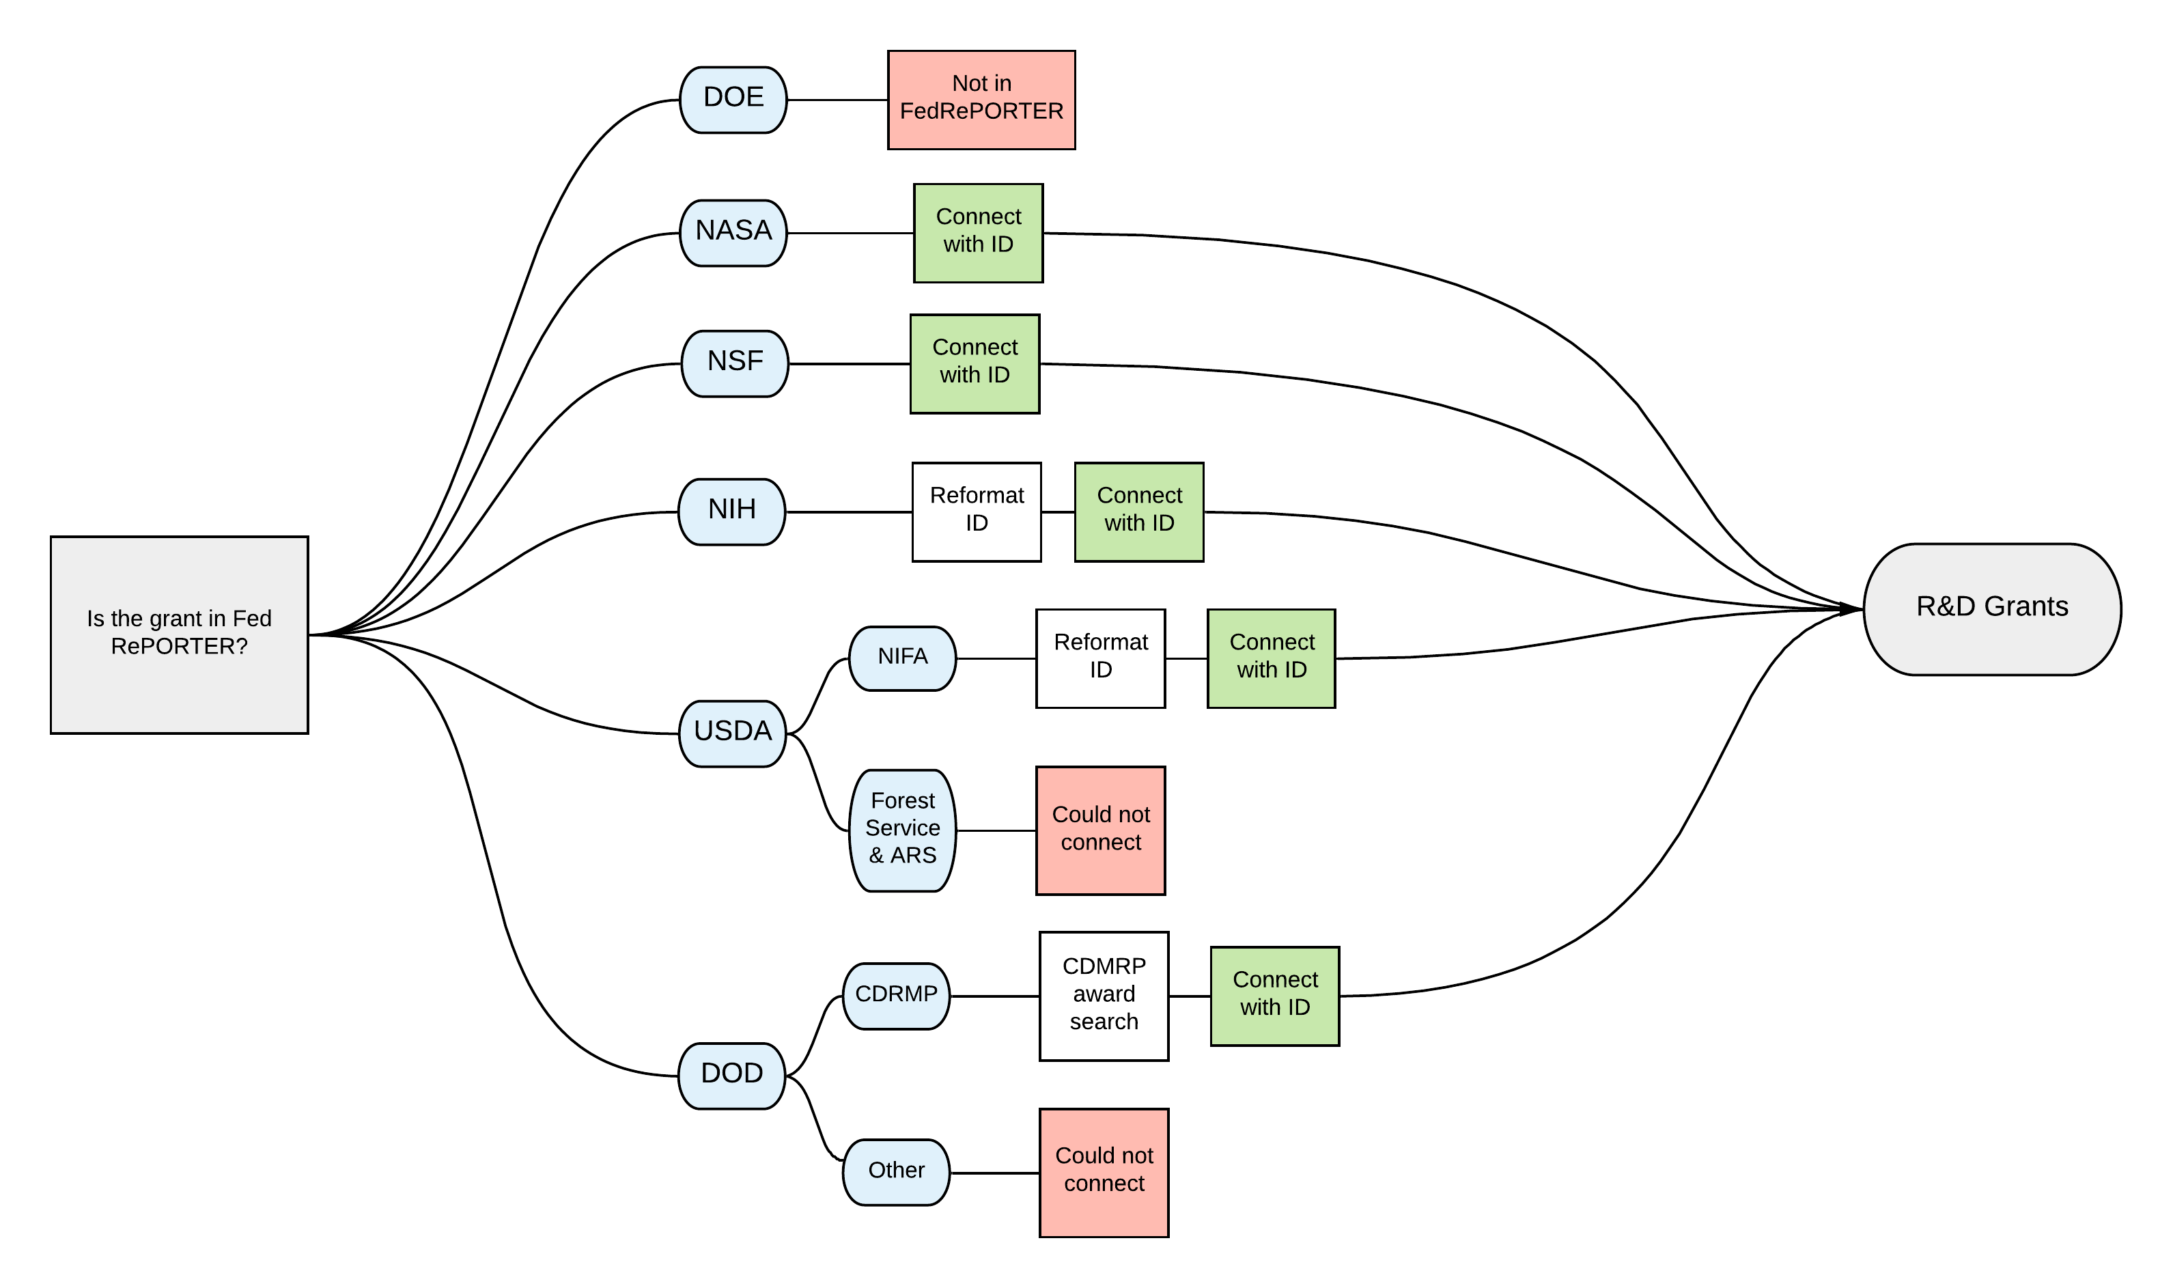
Linking Federal Reporter to USAspending

Slide 23
Linking Project Codes
Not only do projects have vastly different notations across each sub-agency, but the same project can have different codes depending on the database, each containing more embedded information.
Example project from Agency/Sub-Agency | USA Spending Notation | Federal Reporter Notation
DOD – CDMRP The Role of Desert-Dust Metals in the Pathobiology of Gulf War Illness | W81XWH1620050 | GW150034
HHS – NIH VACCINE AND CELL THERAPY CORE LABORATORY | P30CA016087 | 4P30CA016087-36
USDA – ARS Crop and Water Sustainability in Upper Mississippi River Basin Agroecosystems | 58-5030-5-080-1 | ARS-0429067
DoD Activity Address Code
Gulf War Illness Research Program
National Cancer Institute Funding
Request for additional years of funding
Project conducted through NLAE in Ames, IA
USDA Accession Number

Slide 24
Screening Grants With CFDA Codes

Slide 25
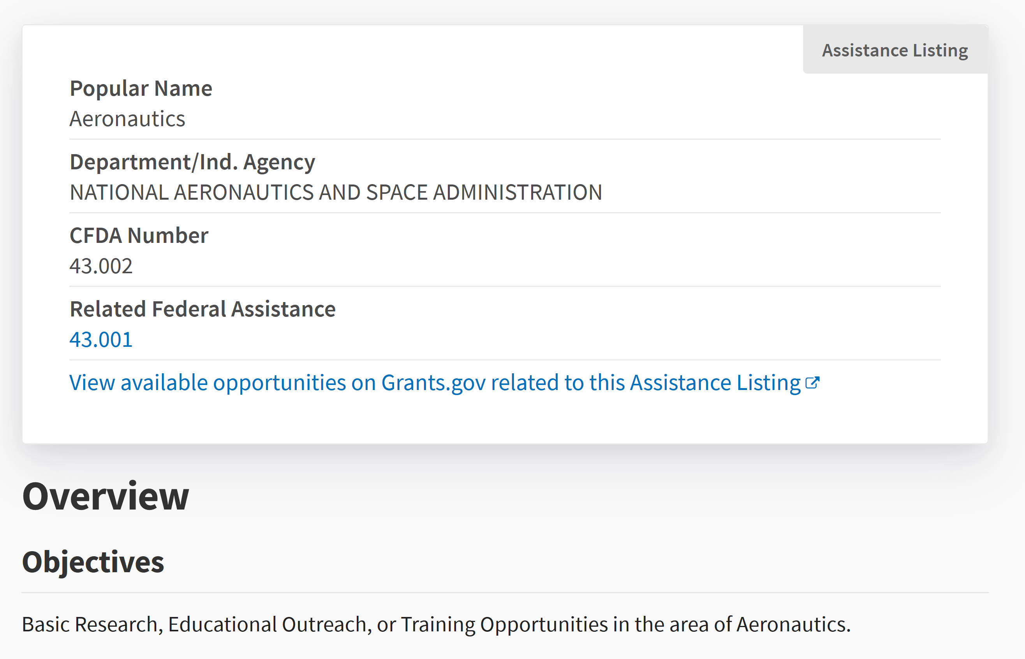
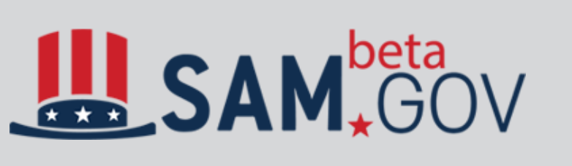
A CFDA code denotes the goals of a particular funding source
Catalogue of Federal and Domestic Assistance: https://beta.sam.gov/search

Slide 26
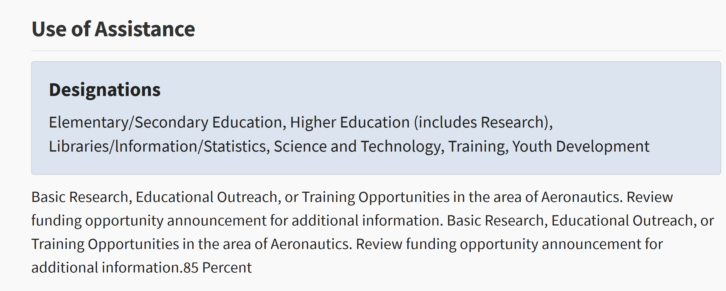
A CFDA code shows S&E, but not its subcomponents

Slide 27
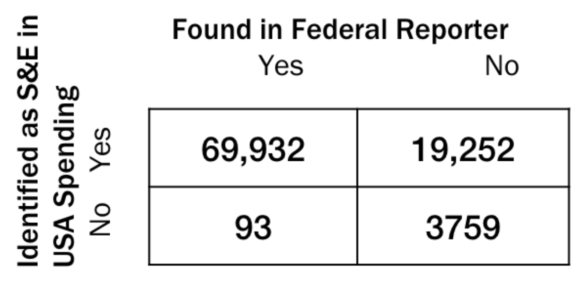
Federal Reporter comparison in agreement with CFDA codes
Used as a sample of R&D grants to test accuracy of our work
CFDA classification method identified 99.9% of grants found in Federal Reporter for FY16

Slide 28
Screening Contracts With Product and Service Codes

Slide 29
Contracts: Product Service Codes provide breakdown of R&D
Products and Service Code Subtypes
Research and Development
Products
Services
Stages of R&D Included
Basic Research
Applied Research and Exploratory Development
Advanced Development
Engineering Development
Operational Systems Development
Management and Support
Commercialization

Slide 30
Original Feasibility Approach
Separate
Screen
Total

Slide 31
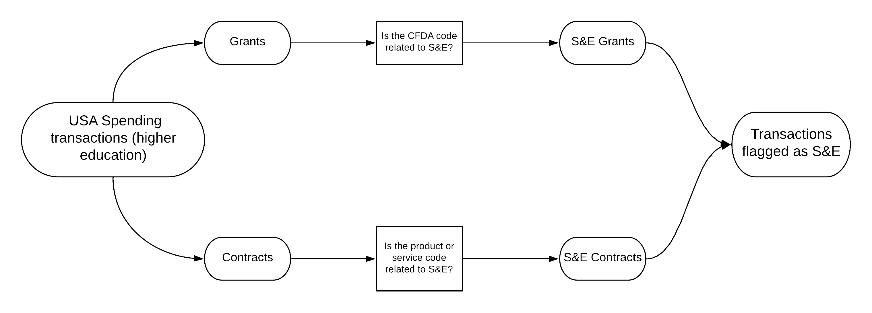
Recommended Feasibility Approach
Separate
Screen
Total

Slide 32
We compared our conservative estimates to the FSS 2016 survey
https://ncsesdata.nsf.gov/fedsupport/2016/html/FSS2016_DST_08.html
Notes:
Analysis limited to funding to overall S&E activity in colleges/universities in 2016.

Slide 33
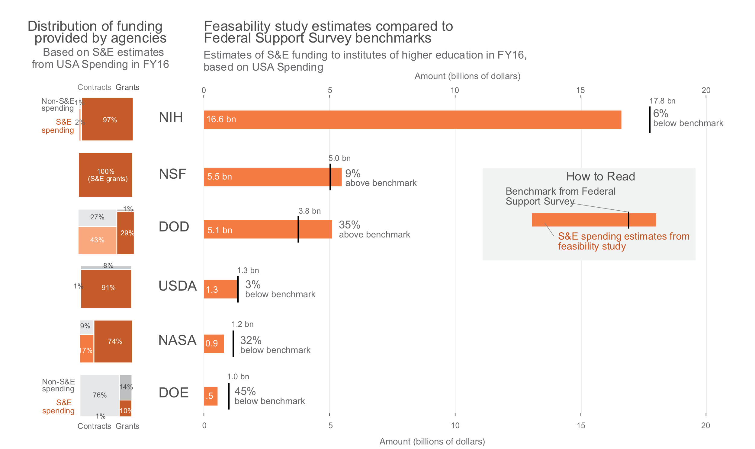
FSS Result is S&E total – R&D Plant

Slide 34
We’ve only just begun!
Refining subtypes of S&E and R&D
Additional microdata, e.g. abstracts
Examining agency-specific databases

Slide 35
Thank You!

Slide 36
Supplementary Slides

Slide 37
Project Summary and Goals
Enhancing or supplementing research and development data
NSF National Center for Science & Engineering Statistics (NCSES) survey (census) data with publicly available administrative data
Providing International Standards for Science, Technology, Innovation (STI) Data
Organisation for Economic Co-operation and Development (OECD) - National Experts on Science and Technology Indicators (NESTI): – our NSF sponsor chairs this working group
Why this matters
Tracking funding to the project level will allow detailed analysis of R&D funding (fields of study, amount of funding, other)
Goals
Document availability and quality of administrative data to measure public R&D expenditures across federal agencies using a common template.
Assess feasibility of building a micro database of public funding for R&D projects based on administrative data
Notes:
Focus on enhancing or supplementing the NSF National Center for Science & Engineering Statistics (NCSES) survey data with publicly available administrative data to better measure public research and development (R&D) projects.
Also of interest to OECD-NESTI: Providing International Standards for Science, Technology, Innovation (STI) Data – our sponsor chairs this working group
Why this matters:
Although federal funding information of public R&D is documented until the agency level, tracking funding to the project level will allow analysis of projects (fields of study, amount of funding, other)
Goals:
Provide documentation about public R&D expenditures across federal agencies using a common template.
Assess feasibility of building a micro database of public funding for R&D projects based on open and available administrative data
Federal R&D data is reported based on high-level, aggregated survey results, so it’s challenging to investigate specific research topics over time, e.g. how much funding is allocated to nanotechnology projects?
This project will allow the NCSES to learn about the feasibility of accessing and analyzing non-survey data about public R&D.
By consolidating screening and organizing R&D funding information into a common template, NCSES can analyze the extent of investment into specific scientific fields.

Slide 38
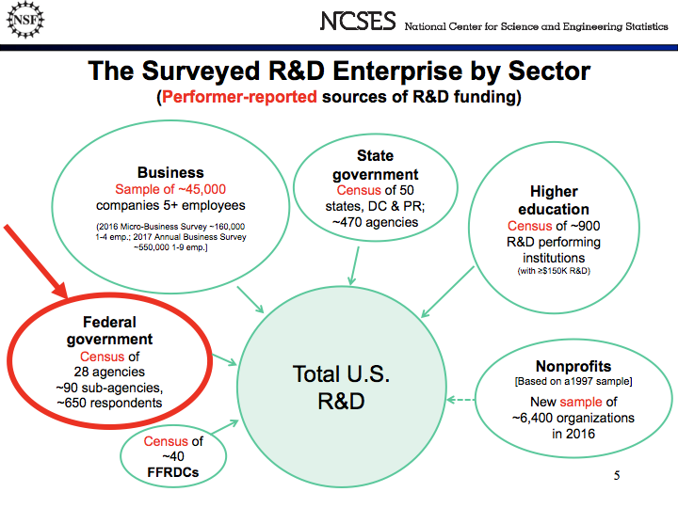
Notes:
The NSF collects data from all sectors about their sources of R&D funding. They collect this data using surveys and censuses. We are interested in assessing the feasibility of measuring federal public funding of R&D to universities and nonprofit organizations using administrative data in place of a survey of federal agencies. (In this case, it is actually a census because all agencies are included.)

Slide 39
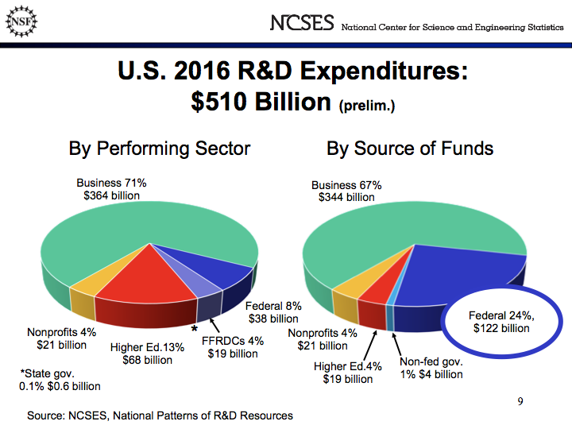
Notes:
We are focusing on measuring the Federal Sources of R&D funding which represents about almost 25% of all sources of R&D fundind or $122 billion.
XX Are we close to this?

Slide 40
Completeness Example
Frequency of Congressional District Entries
How much data is missing?
Created an automated process that returns percentages of complete (not N/A or blank) values for each field in the dataset
Especially relevant for tracking funding amounts and organization name
CONGRESSIONAL_DISTRICT | freq
07 | 12010
02 | 8733
01 | 7612
05 | 7228
N/A | 6560
03 | 6294
12 | 6125
04 | 4090
13 | 3874
09 | 3019

Slide 41
Validity
How much data is relevant and correctly formatted?
Specialized process for each field that tracks amount of incorrectly formatted and misplaced data.
Process returns the percentage of projects and funding inputted correctly
Prepared R scripts to:
Ensure proper formatting for
state abbreviations, zip codes and city names
DUNS numbers, CFDA codes and project IDs
author names, dates and funding totals
Examine each department, agency, state and country name to check valid classifications

